Slide 1
Digital Signal Processing(BEC-42)
Unit-2
Lecture-5
(Problems Based on Bilinear Transformation Method)
Date:07/10/2020

Slide 2
Bilinear Transformation at a glance
BLT differs from the rest of the two methods primarily when it comes to the method of mapping from the ‘s’ plane to the ‘z’ plane.
In Bilinear Transformation, we carry out conformal mapping in which the jΩ axis is mapped onto the unit circle in the ‘z’ plane. This is a one-to-one mapping that does not bring along with it the issue of aliasing.
All points in the left-hand side of the s-plane get mapped inside the unit circle in the z-plane. And all points in the right-hand side of the s-plane get mapped outside the circle in the z-plane.
First, we transform an analog filter, get H(z), and then get a relationship between s and z.
The resulting mapping between the s and z plane cause a frequency distortion. Then we carry out pre-warping to get rid of the effects of frequency warping.

Slide 3




z-plane
s-plane

Slide 4
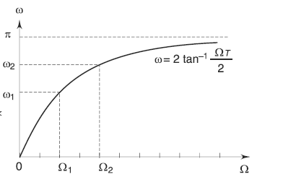
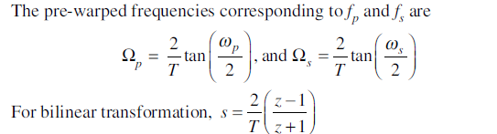

Slide 5

Problem: A digital filter with a 3 dB bandwidth of 0.25𝛑 is to be designed from the analog filter whose system response is
Use BLT and obtain H(z).

Slide 6

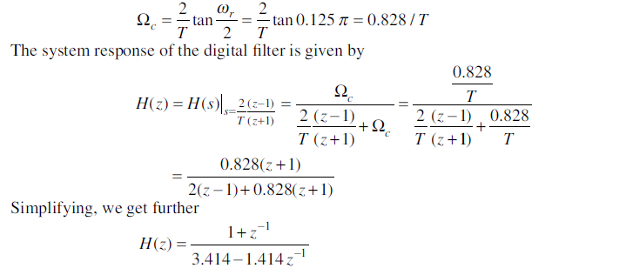
Solution: From the relation , we can write as

Slide 7


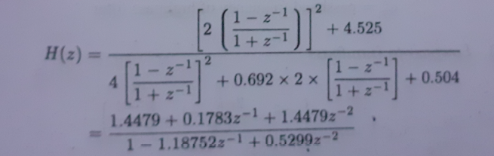
Problem: Determine H(z) that results when the bilinear transformation is applied to
Solution: In bilinear transformation
Let us assume T=1 sec, then

Slide 8

Problem: The transfer function of an analog LPF is
With a bandwidth of 1 rad/s. Use BLT method to design a digital filter with a bandwidth of 20 Hz at a sampling frequency of 60 Hz.

Slide 9
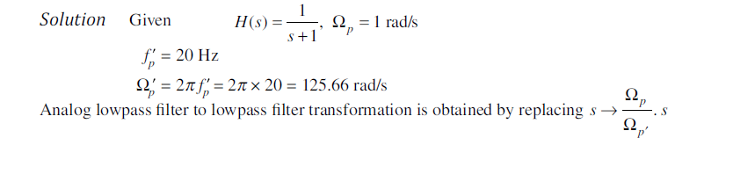
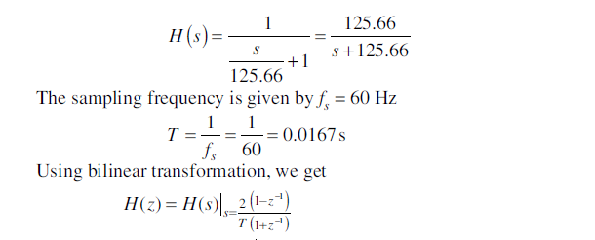

Slide 10
